Slide 1
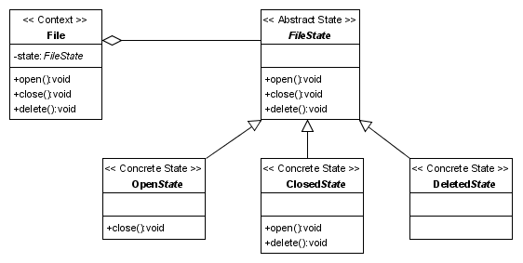
State Pattern
Used in use case controllers
One state per step
Always the same controller
Different implementations
next() goes on to the next state
Easy creation of new states
Notes:
Eigenes Diagramm erstellen?
Our team made the decission to use the state pattern in our use case controllers.
For each step in the process, displayed as a single view in the user interface we created one state.
From the outside, we always use the same controller, but depending on the current state, differents actions are performed or an exception is thrown in the case, that this operation is not accessible in the current state.
In example: the next method is implemented in every state, but depending on the state, the next state is another one.
Other functions, like for instance the pay function, are only implemented in one state.
Another advantage of of the state pattern is the easy way to create new states. You can just insert a new class and link it depending on the called functions together with the ither states.

Slide 2
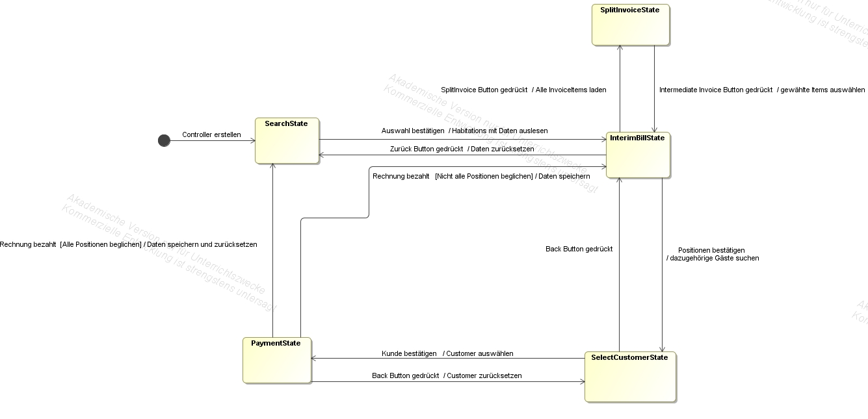
Example: create invoice
Notes:
Diagramm übersetzen? Notwendig? Nur states, dafür größer?
The creation of invoices needs four or five steps, depending on the need of splitting the invoice.
Each step provides different functionalities and when you want to go on, the next() method saves the changed data and initializes the next step.
When the invoice gets paid, the next state depends on wheter all items are paid or not. If there are „open“ items, the next step is the intermediate invoice state, in the other case we go back to the search state, where the different habitations can be searched and selected.
The state pattern helps us to guarantee that we are not able to call methods, which shouldn‘t be accessible in different cases and also manages the process of the use case.

